Slide 1
Ensemble Learning
(Bagging and Boosting)

Slide 2
What is Ensemble?
Suppose you pose a complex question to thousands of random people, then aggregate their answers. In many cases you will find that this aggregated answer is better than an expert’s answer. This is called the wisdom of the crowd. Similarly, if you aggregate the predictions of a group of predictors (such as classifiers or regressors), you will often get better predictions than with the best individual predictor. A group of predictors is called an ensemble; thus, this technique is called Ensemble Learning, and an Ensemble Learning algorithm is called an Ensemble method.

Slide 3
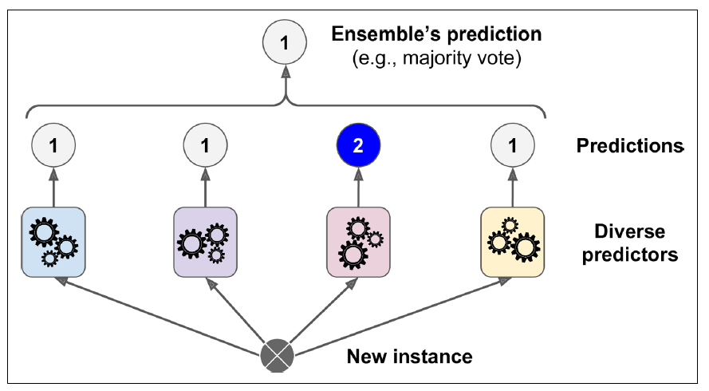
Voting Classifiers
Suppose you have trained a few classifiers, each one achieving about 80% accuracy. You may have a Logistic Regression classifier, an SVM classifier, a Random Forest classifier, a K-Nearest Neighbors classifier, and perhaps a few more.
A very simple way to create an even better classifier is to aggregate the predictions of each classifier and predict the class that gets the most votes. This majority-vote classifier is called a hard voting classifier.

Slide 4
Law of Large Numbers
Somewhat surprisingly, this voting classifier often achieves a higher accuracy than the best classifier in the ensemble. In fact, even if each classifier is a weak learner (meaning it does only slightly better than random guessing), the ensemble can still be a strong learner (achieving high accuracy), provided there are a sufficient number of weak learners and they are sufficiently diverse.
This is due to the law of large numbers.

Slide 5
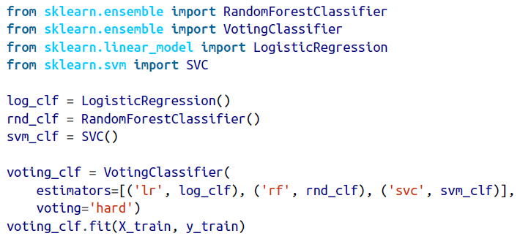
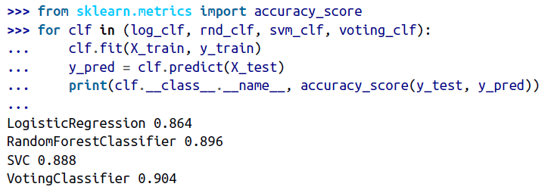
Training a Voting Classifier in Sklearn
There you have it! The voting classifier slightly outperforms all the individual classifiers.

Slide 6
Hard and Soft Voting
Hard Voting | Soft Voting
Here every individual classifier votes for a class, and the majority wins. In statistical terms, the predicted target label of the ensemble is the mode of the distribution of individually predicted labels. | Here every individual classifier provides a probability value that a specific data point belongs to a particular target class. The predictions are weighted by the classifier's importance and summed up. Then the target label with the greatest sum of weighted probabilities wins the vote.
Any classifier can be used. | It is important to assure that the classifiers used can estimate class probabilities (i.e. they must have a predict_proba() method).

Slide 7
Bagging
One way to get a diverse set of classifiers is to use very different training algorithms, as just discussed. Another approach is to use the same training algorithm for every predictor and train them on different random subsets of the training set. When sampling is performed with replacement, this method is called bagging (short for bootstrap aggregating). When sampling is performed without replacement, it is called pasting.
In other words, both bagging and pasting allow training instances to be sampled several times across multiple predictors, but only bagging allows training instances to be sampled several times for the same predictor. This sampling and training process is represented in figure given below.

Slide 8
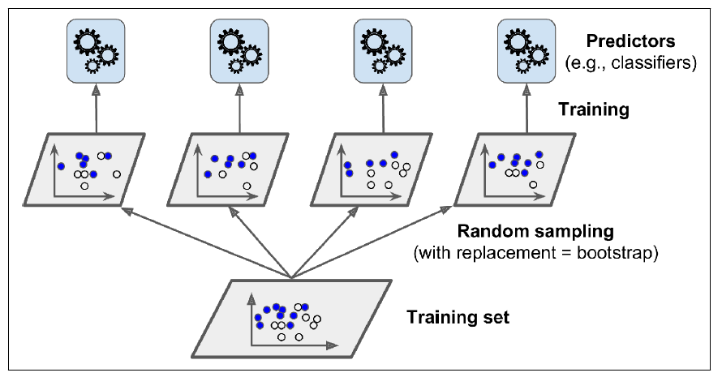

Slide 9
Once all predictors are trained, the ensemble can make a prediction for a new instance by simply aggregating the predictions of all predictors. The aggregation function is typically the statistical mode (i.e., the most frequent prediction, just like a hard voting classifier) for classification, or the average for regression. Each individual predictor has a higher bias than if it were trained on the original training set, but aggregation reduces both bias and variance. Generally, the net result is that the ensemble has a similar bias but a lower variance than a single predictor trained on the original training set.
As shown in the above figure, predictors can all be trained in parallel, via different CPU cores or even different servers. Similarly, predictions can be made in parallel. This is one of the reasons bagging and pasting are such popular methods: they scale very well.

Slide 10
Bagging in Sklearn
Scikit-Learn offers a simple API for both bagging and pasting with the BaggingClassifier class (or BaggingRegressor for regression). The following code trains an ensemble of 500 Decision Tree classifiers:5 each is trained on 100 training instances randomly sampled from the training set with replacement (this is an example of bagging, but if you want to use pasting instead, just set bootstrap=False). The n_jobs parameter tells Scikit-Learn the number of CPU cores to use for training and predictions (–1 tells Scikit-Learn to use all available cores)
The BaggingClassifier automatically performs soft voting instead of hard voting if the base classifier can estimate class probabilities (i.e., if it has a predict_proba() method), which is the case with Decision Tree classifiers.

Slide 11
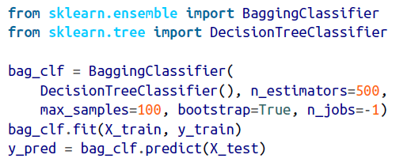
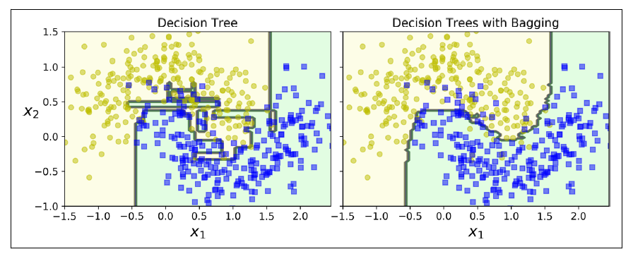

Slide 12
The Figure above compares the decision boundary of a single Decision Tree with the decision boundary of a bagging ensemble of 500 trees (from the preceding code), both trained on the moons dataset. As you can see, the ensemble’s predictions will likely generalize much better than the single Decision Tree’s predictions: the ensemble has a comparable bias but a smaller variance (it makes roughly the same number of errors on the training set, but the decision boundary is less irregular).

Slide 13
Out-of-Bag Evaluation
With bagging, some instances may be sampled several times for any given predictor, while others may not be sampled at all. By default a BaggingClassifier samples m training instances with replacement (bootstrap=True), where m is the size of the training set. This means that only about 63% of the training instances are sampled on average for each predictor.6 The remaining 37% of the training instances that are not sampled are called out-of-bag (oob) instances. Note that they are not the same 37% for all predictors. Since a predictor never sees the oob instances during training, it can be evaluated on these instances, without the need for a separate validation set. You can evaluate the ensemble itself by averaging out the oob evaluations of each predictor

Slide 14
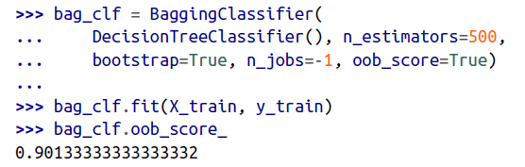
OOB Evaluation in Sklearn
The resulting evaluation score is available through the oob_score_ variable:

Slide 15
Random Forests
Random Forest is an ensemble of Decision Trees, generally trained via the bagging method (or sometimes pasting), typically with max_samples set to the size of the training set.
But before moving on with this ensemble method, let us first take a quick look at the base estimator of this method i.e. Decision Tree.

Slide 16
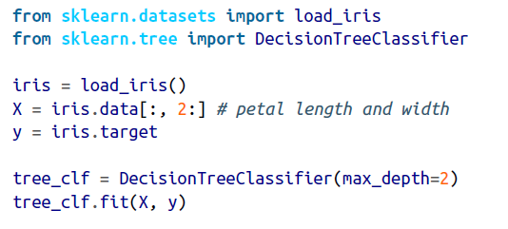
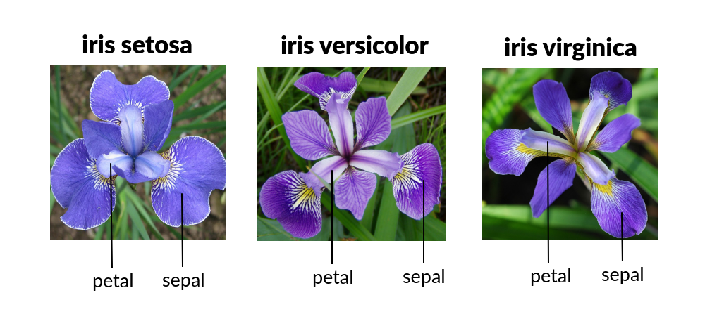
Training Decision Trees
Iris dataset

Slide 17
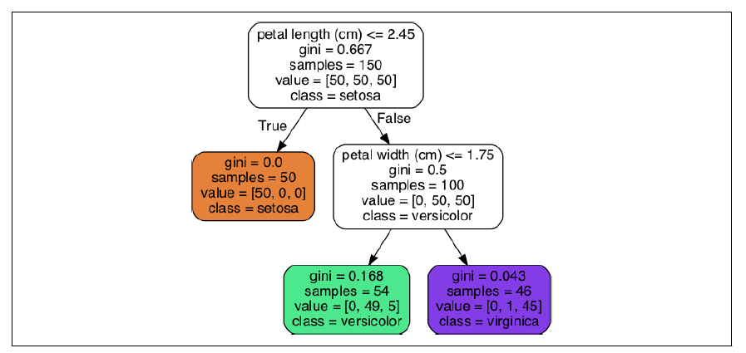
Visualisation
The trained decision tree looks like:-

Slide 18

A node’s samples attribute counts how many training instances it applies to.For example, 100 training instances have a petal length greater than 2.45 cm (depth 1, right), and of those 100, 54 have a petal width smaller than 1.75 cm (depth 2, left).
A node’s value attribute tells you how many training instances of each class this node applies to: for example, the bottom-right node applies to 0 Iris setosa, 1 Iris versicolor, and 45 Iris virginica.
Finally, a node’s gini attribute measures its impurity: a node is “pure” (gini=0) if all training instances it applies to belong to the same class. For example, since the depth-1 left node applies only to Iris setosa training instances, it is pure and its gini score is 0.
The depth-2 left node has a gini score equal to 1 – (0/54)2 – (49/54)2 – (5/54)2 ≈ 0.168.

Slide 19
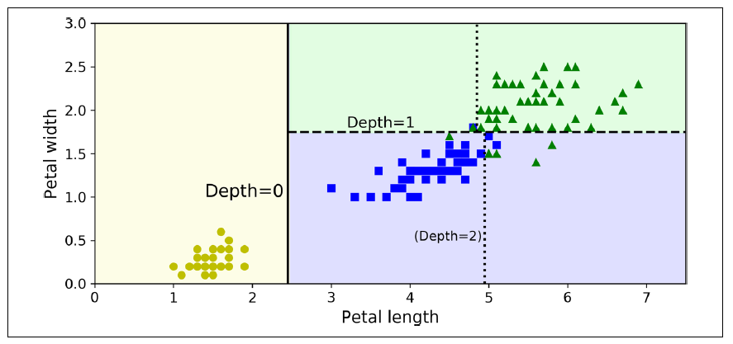

Slide 20
Regularisation Hyperparameter
The DecisionTreeClassifier class has a few parameters that restrict the shape of the Decision Tree: min_samples_split (the minimum number of samples a node must have before it can be split), min_samples_leaf (the minimum number of samples a leaf node must have), min_weight_fraction_leaf (same as min_samples_leaf but expressed as a fraction of the total number of weighted instances), max_leaf_nodes (the maximum number of leaf nodes), and max_features (the maximum number of features that are evaluated for splitting at each node). Increasing min_* hyperparameters or reducing max_* hyperparameters will regularize the model.

Slide 21
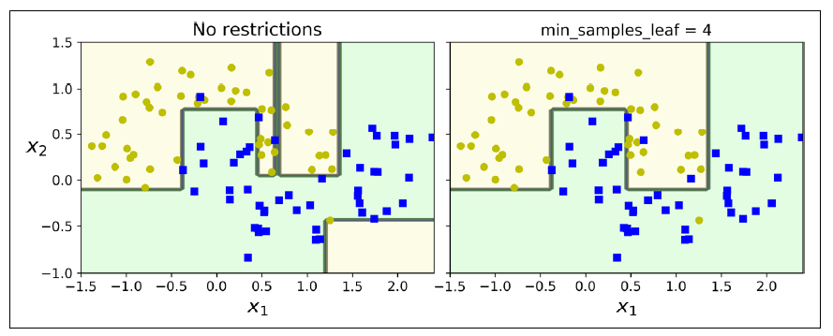

Slide 22
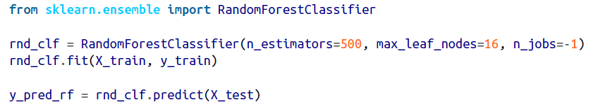
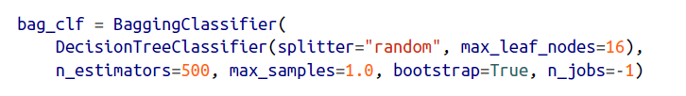
Random Forest classifier in Sklearn
OR

Slide 23
The Random Forest algorithm introduces extra randomness when growing trees; instead of searching for the very best feature when splitting a node, it searches for the best feature among a random subset of features. The algorithm results in greater tree diversity, which (again) trades a higher bias for a lower variance, generally yielding an overall better model.

Slide 24
Extra-Trees
When you are growing a tree in a Random Forest, at each node only a random subset of the features is considered for splitting (as discussed earlier). It is possible to make trees even more random by also using random thresholds for each feature rather than searching for the best possible thresholds (like regular Decision Trees do). A forest of such extremely random trees is called an Extremely Randomized Trees ensemble(or Extra-Trees for short).
You can create an Extra-Trees classifier using Scikit-Learn’s ExtraTreesClassifier class

Slide 25
Feature Importance
Yet another great quality of Random Forests is that they make it easy to measure the relative importance of each feature. Scikit-Learn measures a feature’s importance by looking at how much the tree nodes that use that feature reduce impurity on average (across all trees in the forest). More precisely, it is a weighted average, where each node’s weight is equal to the number of training samples that are associated with it.
Scikit-Learn computes this score automatically for each feature after training, then it scales the results so that the sum of all importances is equal to 1. You can access the result using the feature_importances_ variable

Slide 26
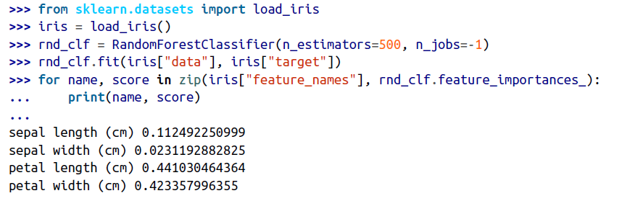
RandomForestClassifier on the iris dataset
Random Forests are very handy to get a quick understanding of what features actually matter, in particular if you need to perform feature selection

Slide 27
Boosting
Boosting (originally called hypothesis boosting) refers to any Ensemble method that can combine several weak learners into a strong learner. The general idea of most boosting methods is to train predictors sequentially, each trying to correct its predecessor. There are many boosting methods available, but by far the most popular are AdaBoost(short for Adaptive Boosting) and Gradient Boosting.
Let’s start with AdaBoost.

Slide 28
AdaBoost
One way for a new predictor to correct its predecessor is to pay a bit more attention to the training instances that the predecessor underfitted. This results in new predictors focusing more and more on the hard cases. This is the technique used by AdaBoost.
For example, when training an AdaBoost classifier, the algorithm first trains a base classifier (such as a Decision Tree) and uses it to make predictions on the training set. The algorithm then increases the relative weight of misclassified training instances. Then it trains a second classifier, using the updated weights, and again makes predictions on the training set, updates the instance weights, and so on as shown in the figure given below:

Slide 29
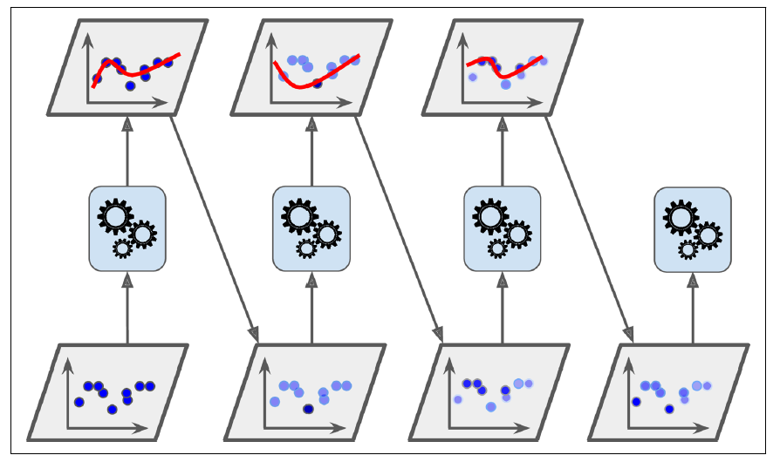

Slide 30
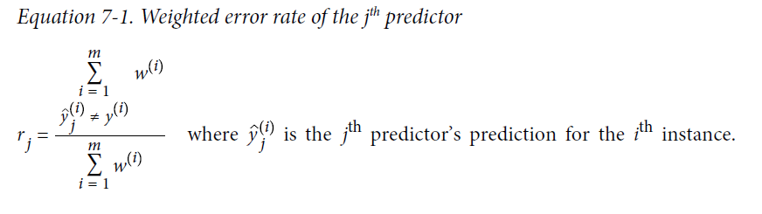
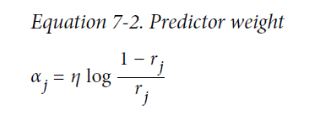
AdaBoost algorithm

Slide 31
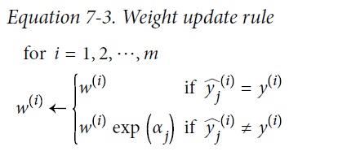
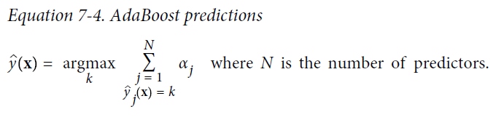

Slide 32
Gradient Boosting
Another very popular boosting algorithm is Gradient Boosting. Just like AdaBoost, Gradient Boosting works by sequentially adding predictors to an ensemble, each one correcting its predecessor. However, instead of tweaking the instance weights at every iteration like AdaBoost does, this method tries to fit the new predictor to the residual errors made by the previous predictor.
Let’s go through a simple regression example, using Decision Trees as the base predictors (of course, Gradient Boosting also works great with regression tasks). This is called Gradient Tree Boosting, or Gradient Boosted Regression Trees (GBRT).

Slide 33



First, let’s fit a DecisionTreeRegressor to the training set:
Next, we’ll train a second DecisionTreeRegressor on the residual errors made by the first predictor:
Then we train a third regressor on the residual errors made by the second predictor:
Now we have an ensemble containing three trees. It can make predictions on a new instance simply by adding up the predictions of all the trees:

Slide 34
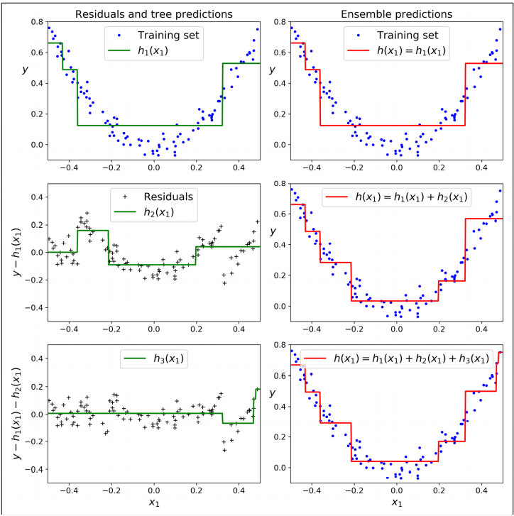

Slide 35
The above figure represents the predictions of these three trees in the left column, and the ensemble’s predictions in the right column. In the first row, the ensemble has just one tree, so its predictions are exactly the same as the first tree’s predictions. In the second row, a new tree is trained on the residual errors of the first tree. On the right you can see that the ensemble’s predictions are equal to the sum of the predictions of the first two trees. Similarly, in the third row another tree is trained on the residual errors of the second tree. You can see that the ensemble’s predictions gradually get better as trees are added to the ensemble.

Slide 36
Regularization
The learning_rate hyperparameter scales the contribution of each tree. If you set it to a low value, such as 0.1, you will need more trees in the ensemble to fit the training set, but the predictions will usually generalize better. This is a regularization technique called shrinkage.
The figure given below shows two GBRT ensembles trained with a low learning rate: the one on the left does not have enough trees to fit the training set, while the one on the right has too many trees and overfits the training set.

Slide 37
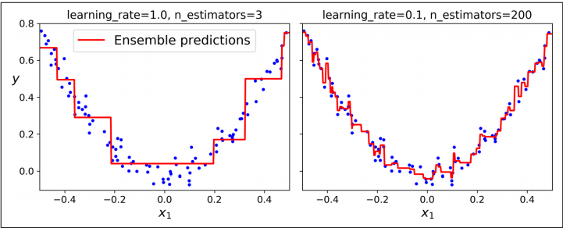

Slide 38
In order to find the optimal number of trees, you can use early stopping. A simple way to implement this is to use the staged_predict() method: it returns an iterator over the predictions made by the ensemble at each stage of training (with one tree, two trees, etc.).
The following code trains a GBRT ensemble with 120 trees, then measures the validation error at each stage of training to find the optimal number of trees, and finally trains another GBRT ensemble using the optimal number of trees:

Slide 39
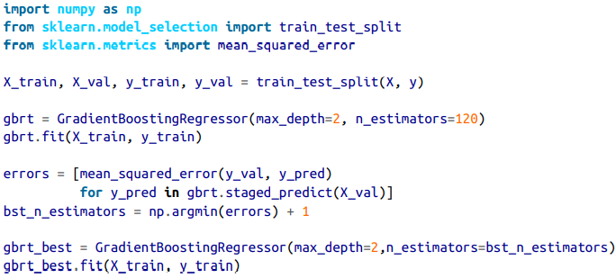
GBRT ensemble in Sklearn

Slide 40
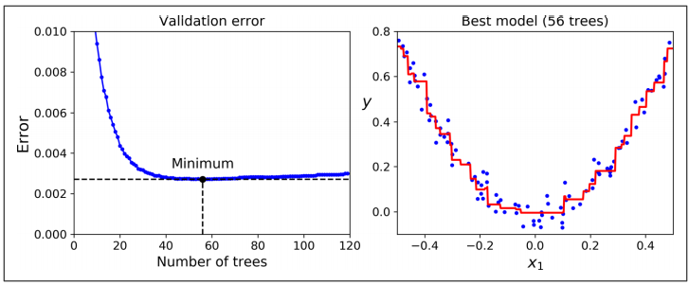
The validation errors are represented on the left, and the best model’s predictions are represented on the right.

Slide 41
The GradientBoostingRegressor class also supports a subsample hyperparameter, which specifies the fraction of training instances to be used for training each tree. For example, if subsample=0.25, then each tree is trained on 25% of the training instances, selected randomly. As you can probably guess by now, this technique trades a higher bias for a lower variance. It also speeds up training considerably. This is called Stochastic Gradient Boosting.

Slide 42
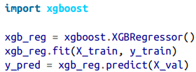

XGBoost
It is worth noting that an optimized implementation of Gradient Boosting is available in the popular Python library XGBoost, which stands for Extreme Gradient Boosting. This package was initially developed by Tianqi Chen as part of the Distributed (Deep) Machine Learning Community (DMLC), and it aims to be extremely fast, scalable, and portable.
XGBoost also offers several nice features, such as automatically taking care of early stopping:
You should definitely check it out!

Slide 43
Assignment
Use the following Classifier on Moons dataset →
Voting Classifier
Adaboost Classifier
Bagging Classifier
Use sklearn.datasets.make_moons function for Moons dataset.

